Slide 1
Chapter 2

Slide 2
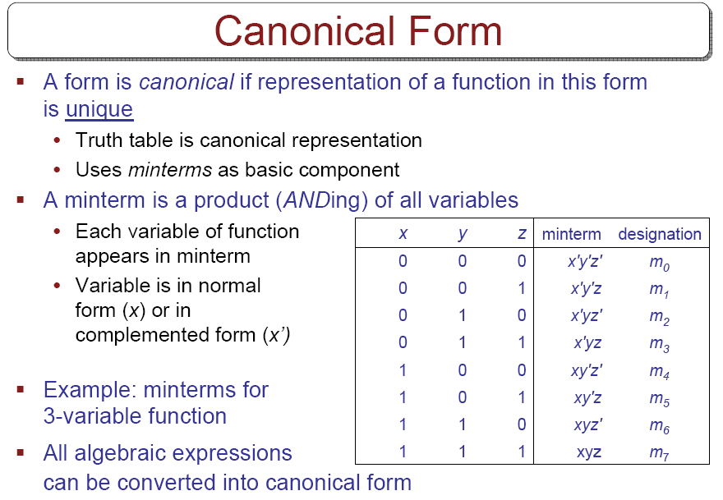

Slide 3
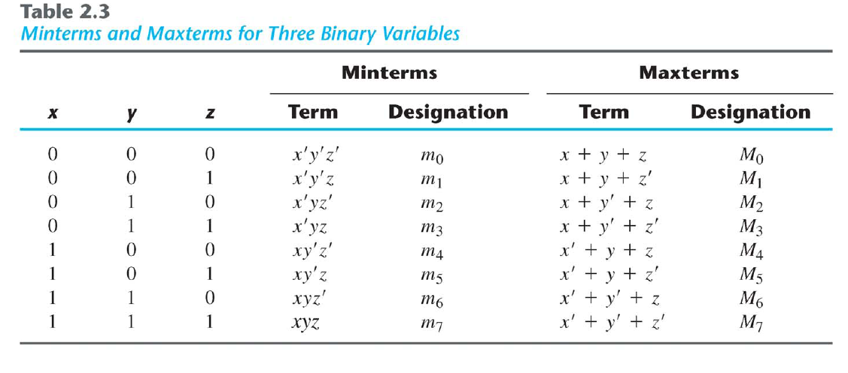
Minterms & Maxterms

Slide 4
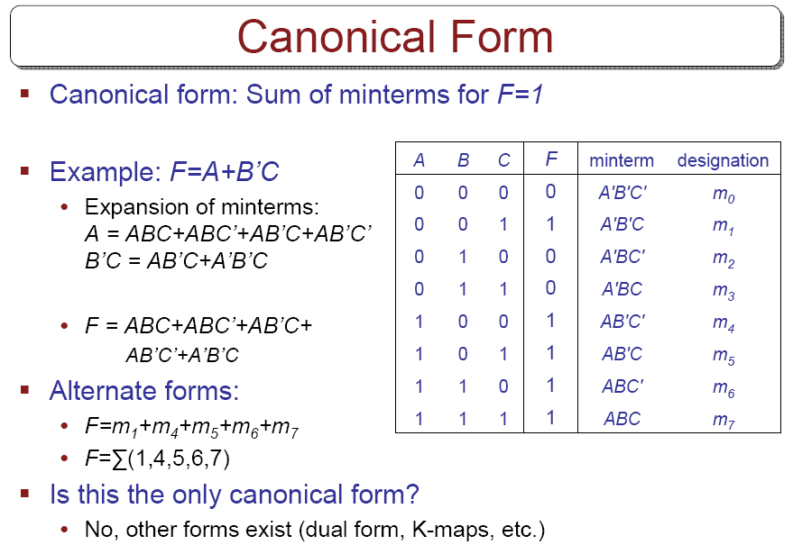

Slide 5
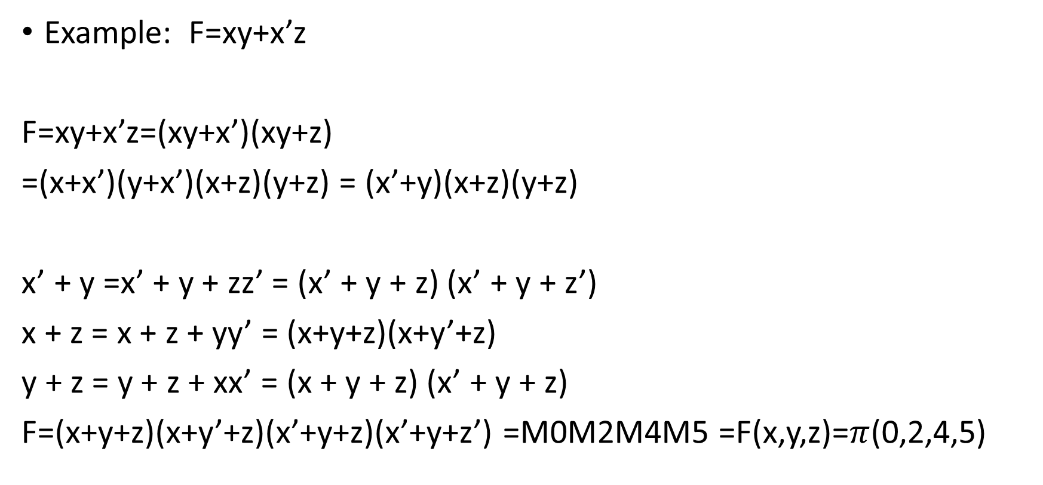
PRODUCT OF MAXTERMS
Example: F=xy+x’z
F=xy+x’z=(xy+x’)(xy+z)
=(x+x’)(y+x’)(x+z)(y+z) = (x’+y)(x+z)(y+z)
x’ + y =x’ + y + zz’ = (x’ + y + z) (x’ + y + z’)
x + z = x + z + yy’ = (x+y+z)(x+y’+z)
y + z = y + z + xx’ = (x + y + z) (x’ + y + z)
F=(x+y+z)(x+y’+z)(x’+y+z)(x’+y+z’) =M0M2M4M5 =F(x,y,z)=$π$(0,2,4,5)

Slide 6
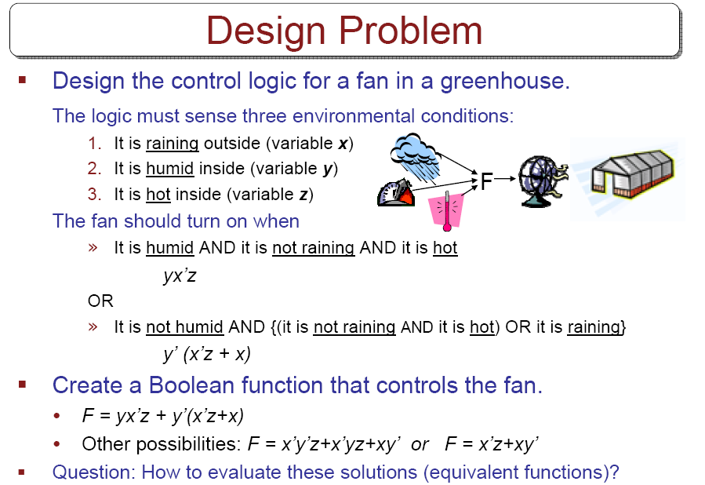

Slide 7
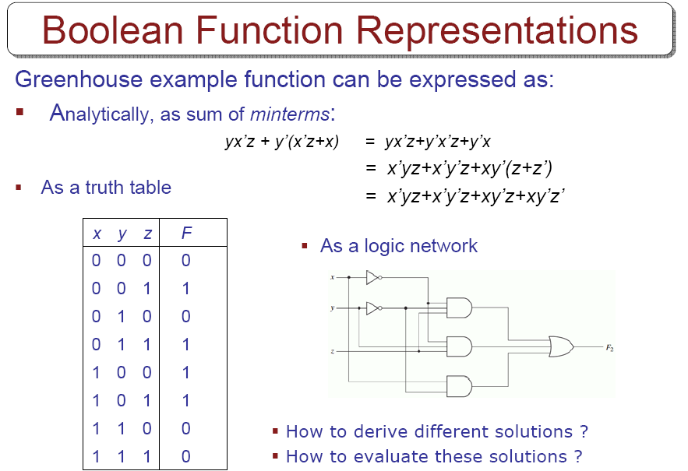

Slide 8
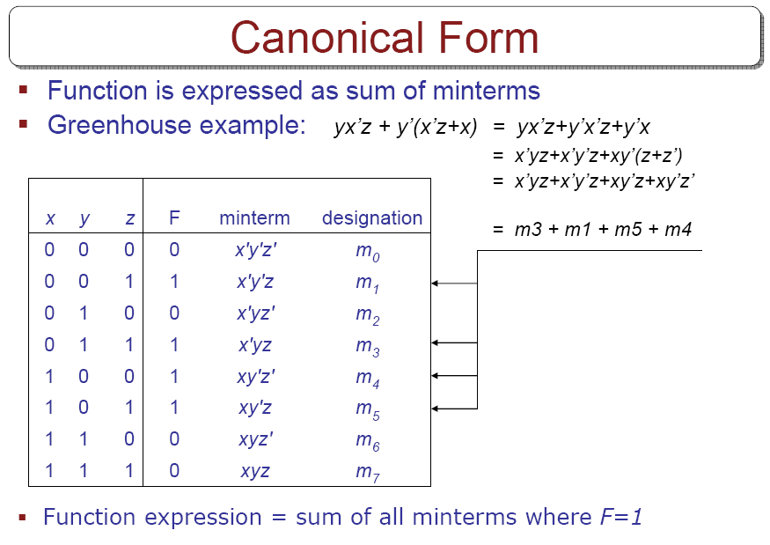

Slide 9
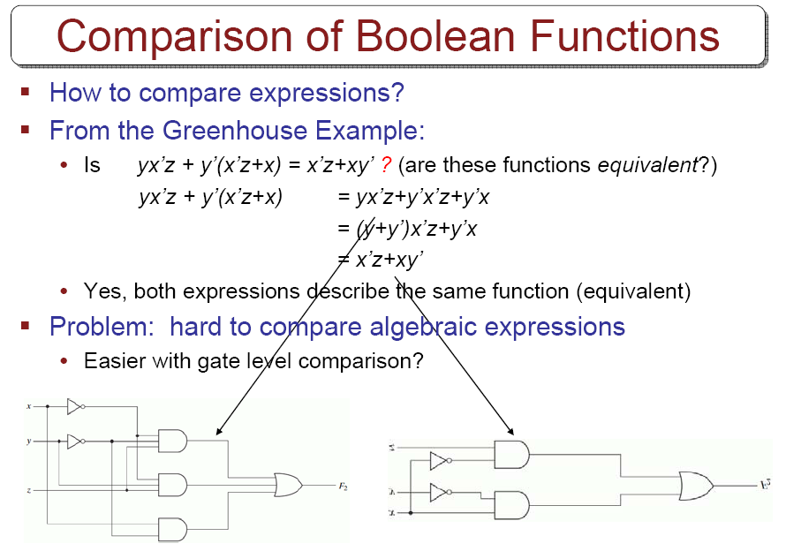

Slide 10
Conversion between Canonical Forms
F(A,B,C)=∑(1,4,5,6,7)
F’(A,B,C)=∑(0,2,3)=m₀+m₂+m₃
By DeMorgan’s
F=(m₀+m₂+m₃)’=m₀’m₂’m₃’=M₀M₂M₃=∏(0,2,3)

Slide 11
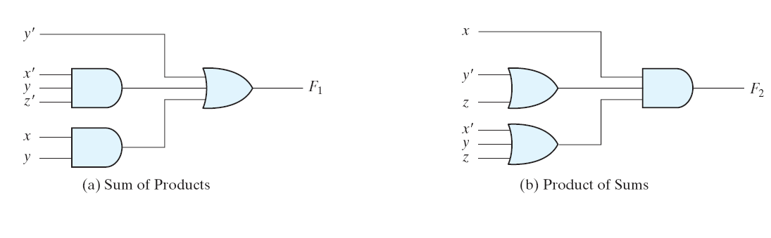
Standart forms
F1=?
F2=?

Slide 12
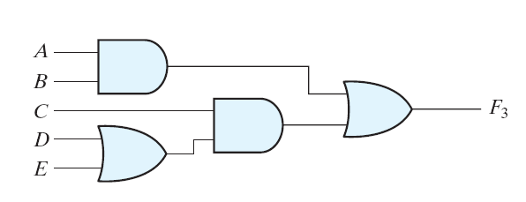
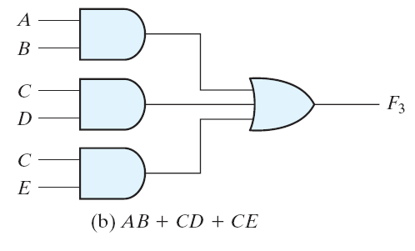
Three- and two-level implementation
Difference?

Slide 13
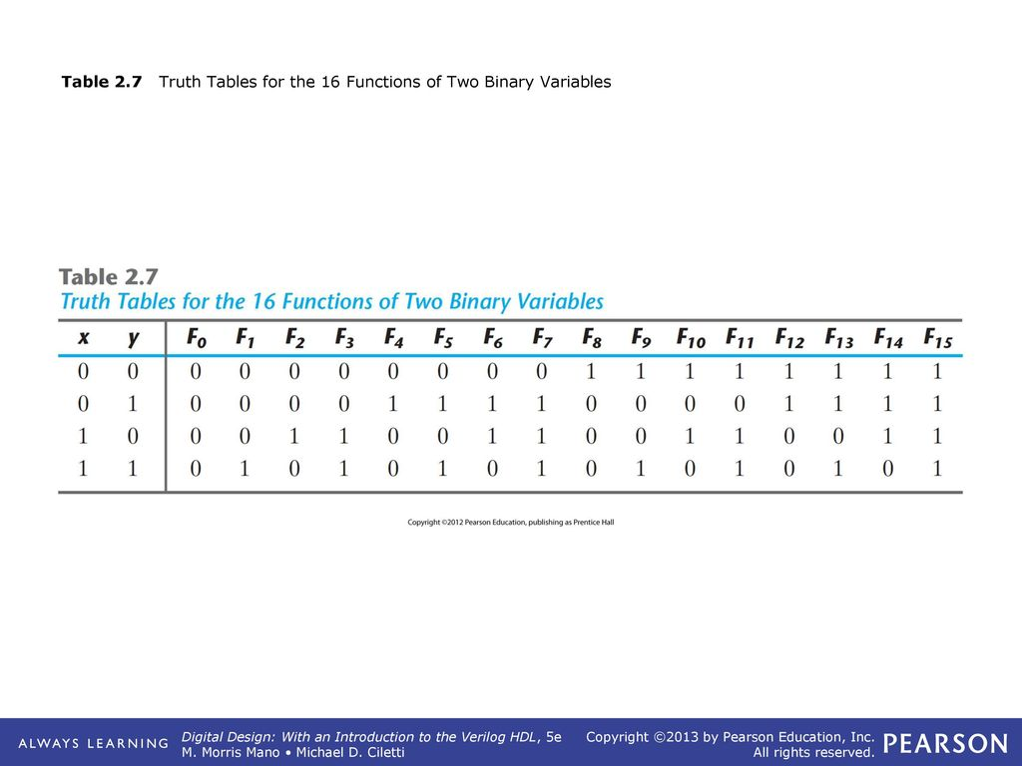
Other Logical Operations

Slide 14
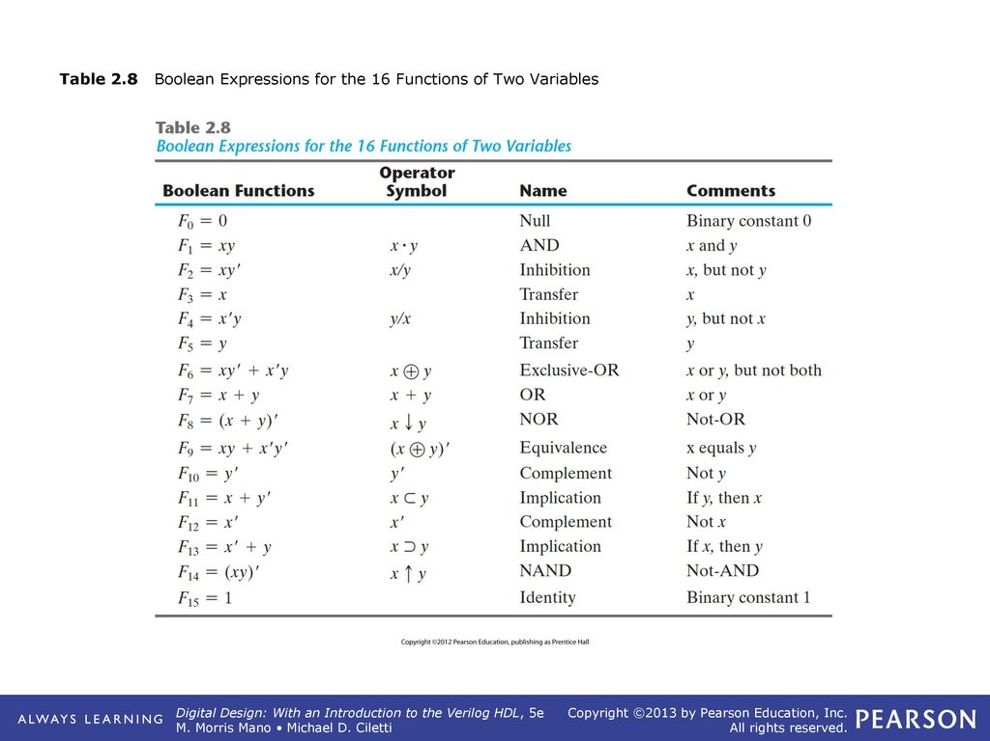

Slide 15
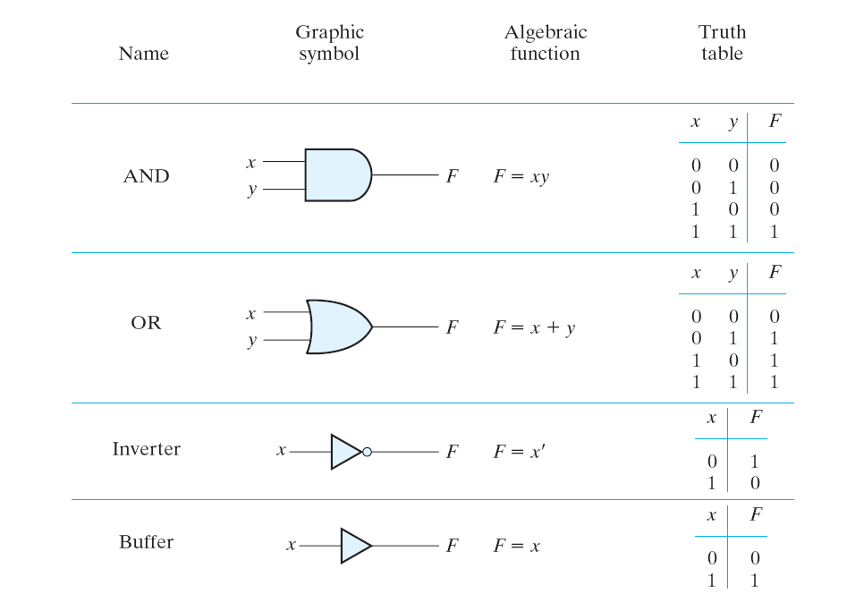

Slide 16
